Slide 1
Software Processes

Slide 2
The software lifecycle & process
A structured set of activities required to develop a
software system (software lifecycle).
  Specification;
  Design;
  Development;
  Validation;
  Evolution.
A software process model is an abstract representation of a process. It presents a description of a process from some particular perspective.

Slide 3
Generic software process models
The waterfall model
  Separate and distinct phases of specification and development.
Evolutionary development
  Specification, development and validation are interleaved.
Component-based software engineering
  The system is assembled from existing components.
There are many variants of these models e.g. formal development where a waterfall-like process is used but the specification is a formal specification that is refined through several stages to an implementable design.

Slide 4
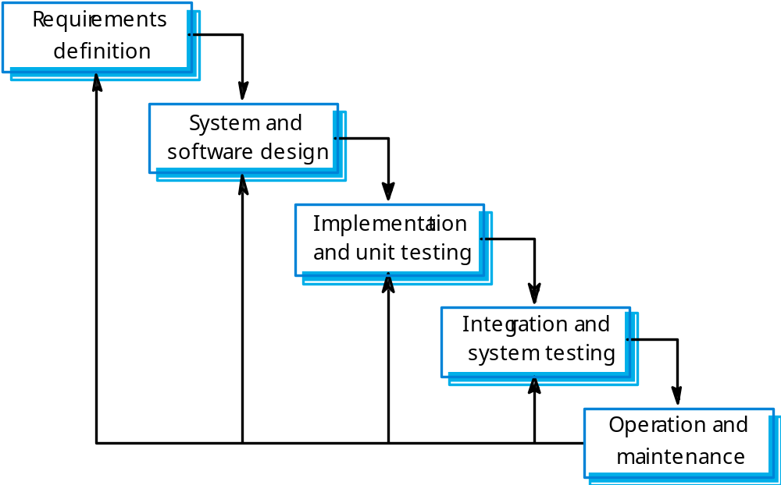
Waterfall model

Slide 5
Waterfall model phases
Requirements analysis and definition
System and software design
Implementation and unit testing
Integration and system testing
Operation and maintenance
The main drawback of the waterfall model is the difficulty of accommodating change after the process is underway. One phase has to be complete before moving onto the next phase.

Slide 6
Waterfall model problems
Inflexible partitioning of the project into distinct stages makes it difficult to respond to changing customer requirements.
Therefore, this model is only appropriate when the requirements are well-understood and changes will be fairly limited during the design process.
Few business systems have stable requirements.
The waterfall model is mostly used for large systems engineering projects where a system is developed at several sites.

Slide 7
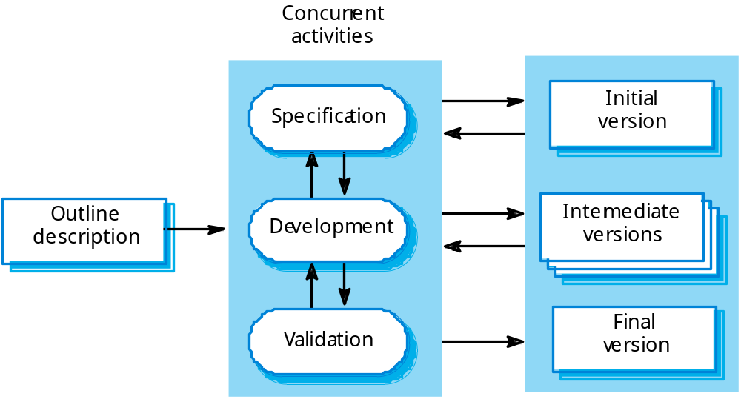
Evolutionary development

Slide 8
Evolutionary development
Problems
  Lack of process visibility;
  Systems are often poorly structured;
  Special skills (e.g. in languages for rapid prototyping) may be required.
Applicability
  For small or medium-size interactive systems;
  For parts of large systems (e.g. the user interface);
  For short-lifetime systems.

Slide 9
Component-based software engineering
Based on systematic reuse where systems are integrated from existing components or COTS (Commercial-off-the-shelf) systems.
Process stages
  Component analysis;
  Requirements modification;
  System design with reuse;
  Development and integration.
This approach is becoming increasingly used as component standards have emerged.

Slide 10
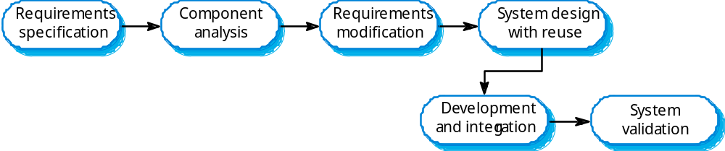
Reuse-oriented development

Slide 11
Process activities
(Software Lifecycle)
Software specification
Software design
Software implementation
Software validation
Software evolution

Slide 12
Software specification
The process of establishing what services are required and the constraints on the system’s operation and development.
Requirements engineering process
  Feasibility study;
  Requirements elicitation and analysis;
  Requirements specification;
  Requirements validation.

Slide 13
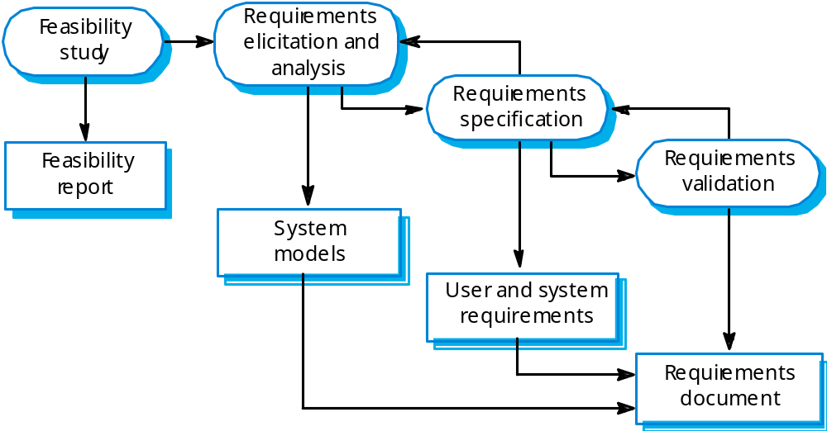
The requirements engineering process

Slide 14
Software design and implementation
The process of converting the system specification into an executable system.
Software design
  Design a software structure that realises the specification;
Implementation
  Translate this structure into an executable program;
The activities of design and implementation are closely related and may be inter-leaved.

Slide 15
Design process activities
Architectural design
Abstract specification
Interface design
Component design
Data structure design
Algorithm design

Slide 16
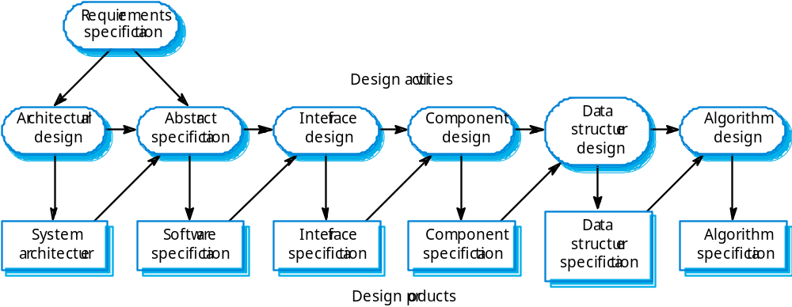
The software design process

Slide 17
Structured methods
Systematic approaches to developing a software design.
The design is usually documented as a set of graphical models.
Possible models
  Object model;
  Sequence model;
  State transition model;
  Structural model;
  Data-flow model.

Slide 18
Programming and debugging
Translating a design into a program and removing errors from that program.
Programming is a personal activity - there is no generic programming process.
Programmers carry out some program testing to discover faults in the program and remove these faults in the debugging process.

Slide 19
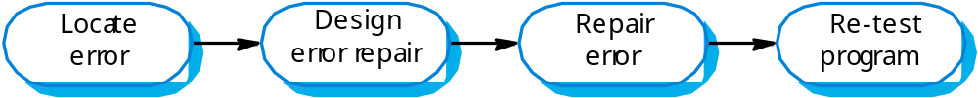
The debugging process

Slide 20
Software validation
Verification and validation (V & V) is intended to show that a system conforms to its specification and meets the requirements of the system customer.
Involves checking and review processes and system testing.
System testing involves executing the system with test cases that are derived from the specification of the real data to be processed by the system.

Slide 21
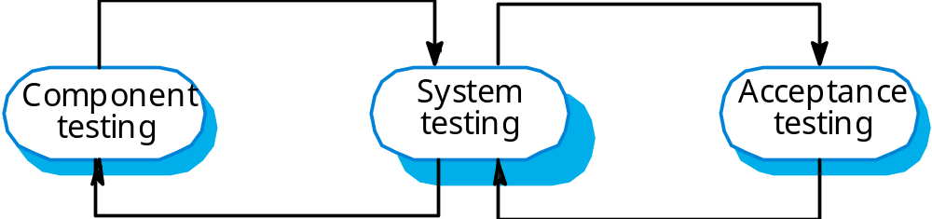
The testing process

Slide 22
Testing stages
Component or unit testing
  Individual components are tested independently;
  Components may be functions or objects or coherent groupings of these entities.
System testing
  Testing of the system as a whole. Testing of emergent properties is particularly important.
Acceptance testing
  Testing with customer data to check that the system meets the customer’s needs.

Slide 23
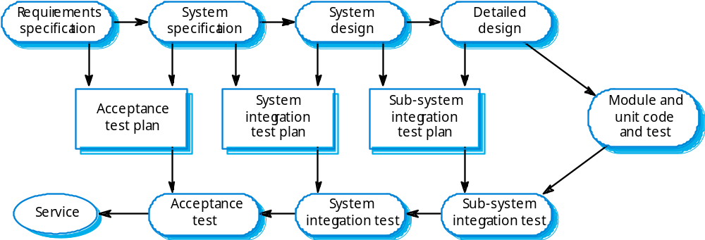
Testing phases

Slide 24
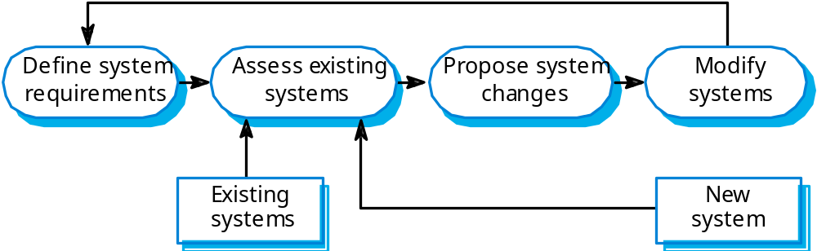
System evolution

Slide 25
Key points
Software processes are the activities involved in producing and evolving a software system.
Software process models are abstract representations of these processes.
General activities are specification, design and implementation, validation and evolution.
Generic process models describe the organisation of software processes. Examples include the waterfall model, evolutionary development and component-based software engineering.
Iterative process models describe the software process as a cycle of activities.

Slide 26
Key points
Requirements engineering is the process of developing a software specification.
Design and implementation processes transform the specification to an executable program.
Validation involves checking that the system meets to its specification and user needs.
Evolution is concerned with modifying the system after it is in use.
The Rational Unified Process is a generic process model that separates activities from phases.
CASE technology supports software process activities.

